Slide 1
ACOUSTICS
Presented By
Prof. D. M. Parshuramkar
Dept. Of Physics
N. H. College, Bramhapuri

Slide 2
Introduction
Acoustics
It is the interdisciplinary science that deals with the study of all mechanical waves in gases, liquids, and solids including topics such as vibration, sound, ultrasound and infrasound.
Acoustics
Physical Acoustics
Biological Acoustics
Acoustical Engineering
Aero acoustics
Bioacoustics
Acoustical Measurement and Instrumentation
General Linear acoustics
Musical acoustics
Acoustical Signal Processing
Non-Linear acoustics
Physiological acoustics
Architectural acoustics
Structural acoustics and vibration
Psychoacoustics
Environmental acoustics
Under water sound
Speech Communication
Transduction
Ultrasonic
Room Acoustics

Slide 3
Architectural Acoustics :
(It is also known as room acoustics and building acoustics) is the science and engineering of achieving a good sound within a building and is a branch of acoustical engineering.

Slide 4
Cont…..
The study of acoustics revolves around the generation, propagation and reception of mechanical waves and vibrations.
Cause
Generating Mechanism (transduction)
Acoustic Wave Propagation
Reception (transduction)
Effect
The steps shown in the above diagram can be found in any acoustical event or process.

Slide 5
Figure: Applicati0ns and relations of Acoustics

Slide 6
An Analysis of Different Parameters of Architectural Buildings
There are many parameters related with architectural buildings. Some parameters are pointed out below:-
The model theory
The geometric theory
The theory of Sabine & reverberation
Acoustic intensity and decibel
Boundary conditions
Noise effect
Loudness
Focussing
Echelon effect
Extraneous noise
Resonance
Temperature
Absorbing material
Pitch

Slide 7
Study and Measurement of Sound Absorption Coefficients of Materials
Performance of sound absorbing materials is defined by a set of experimentally determined constants i.e. absorption coefficient, reflection coefficient, acoustic impedance, propagation constant, normal reduction coefficient, transmission loss.
The sound absorption coefficient of a surface is defined as the ratio of the sound energy absorbed by the surface to that falling on it.
Absorption coefficient of materials vary at the different frequency.
Absorption of sound by materials is due to the porosity, compressibility and elasticity. The materials absorb sound when the sound waves are dissipated into heat by friction in the narrow pores.
Some of the materials are compressible, such as hair felt, carpets etc. some absorb sound by vibrating, as is probably the case with thin glass, wood, and suspended plaster ceilings.

Slide 8
Factors Influencing Sound Absorption
Fiber Size
Airflow Resistance
Porosity
Tortuosity
Thickness
Density
Compression
Surface Impedance
Placement / Position of Sound Absorptive

Slide 9
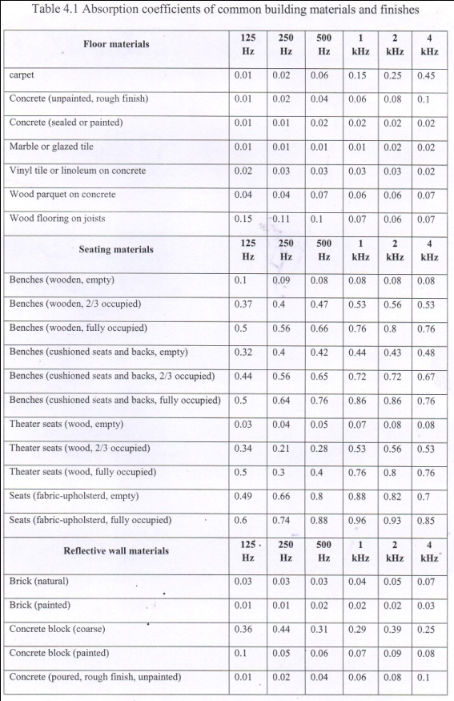
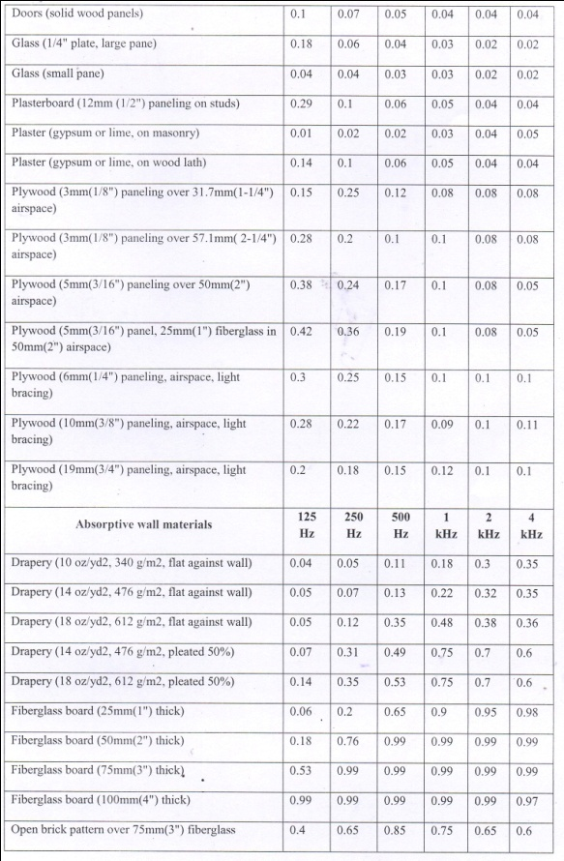
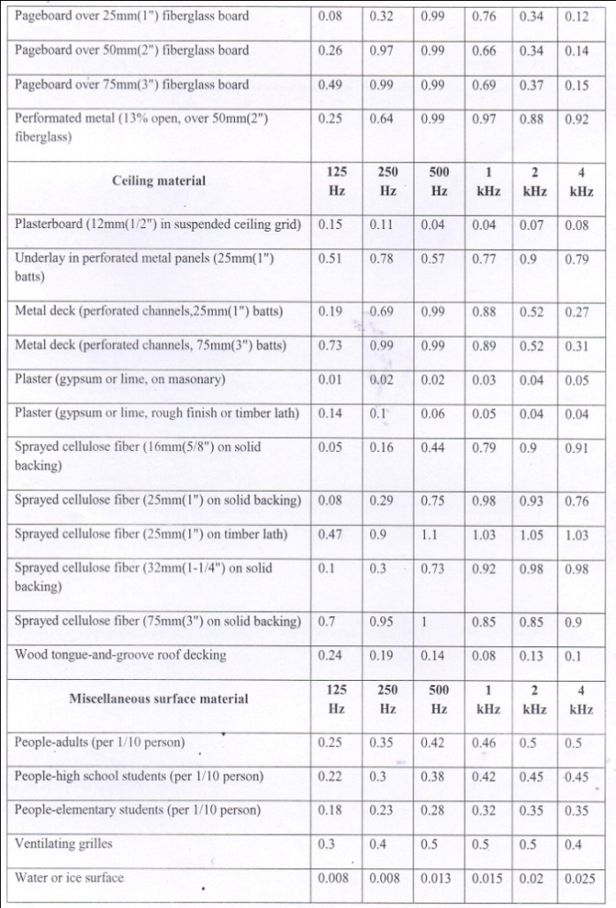
A chart of absorption coefficient of material has been shown at different frequency levels

Slide 10
Room Acoustics
Conditions to provide good listening in rooms for speech and music
Good access to the direct sound for all people in the room.
To limit background noise level in the room
To limit the reverberation time in the room

Slide 11
A Study of Major Architecture Buildings of India
Historical and architectural monuments of India has been explained.
The branches of architecture are civil, sacred, naval, military, and landscape architecture.
In India there are various types of architectural monuments such as Taj Mahal, Qutub Minar, Red Fort, Agra Fort, Akshardham Temple, Ujjain Temple, Mahamaya Temple etc.
In the world there are 22 famous buildings to inspire us.

Slide 12
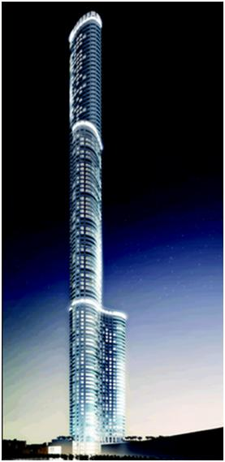
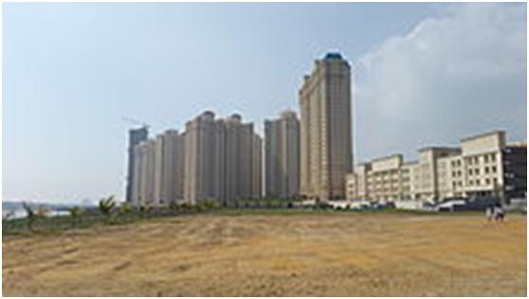
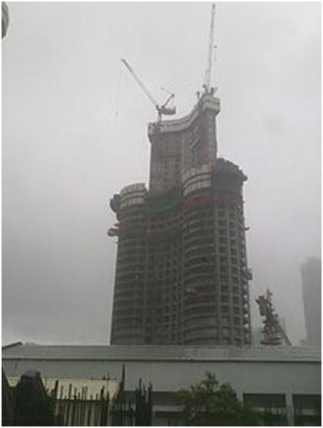
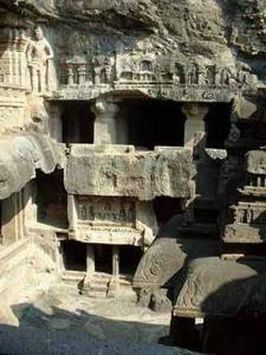
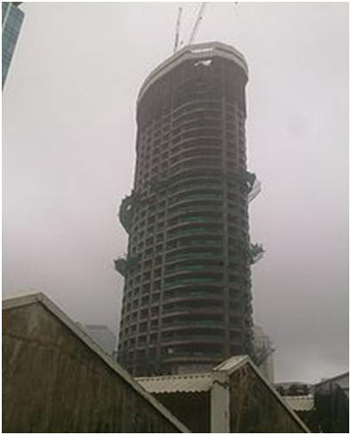
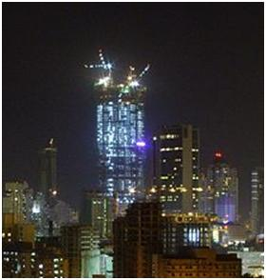
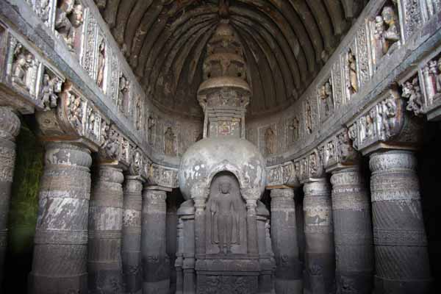
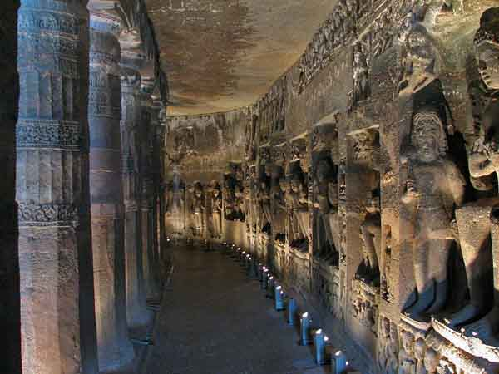
VARIOUS ARCHITECTURAL BUILDINGS

Slide 13
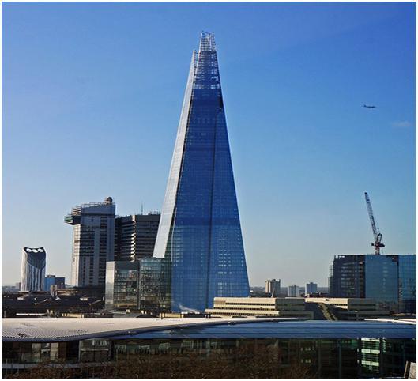
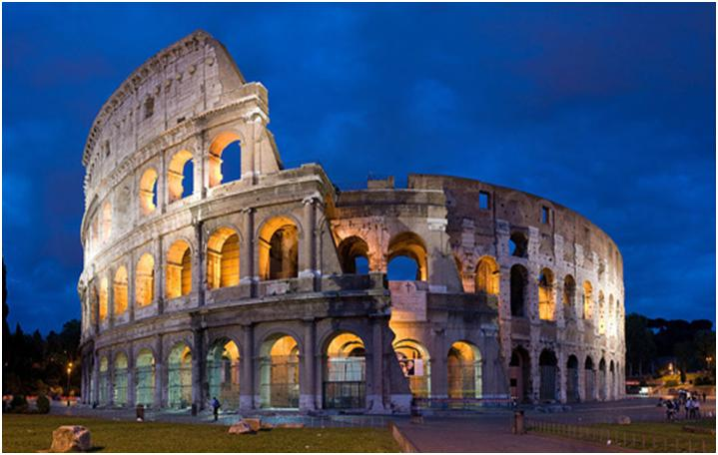
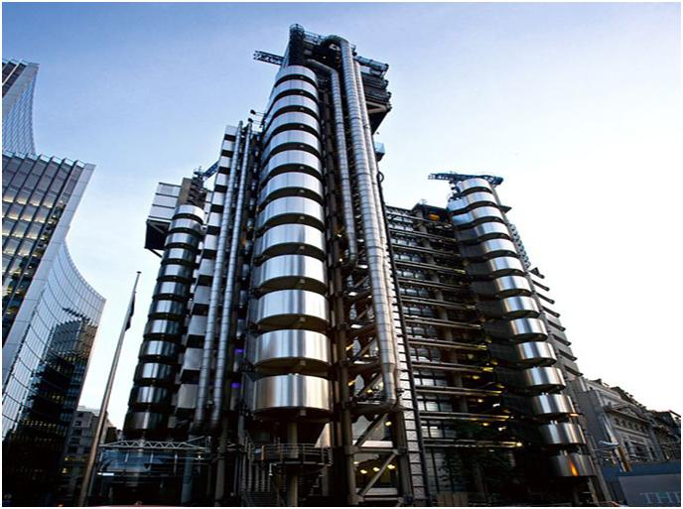
WORLD FAMOUS BUILDINGS TO INSPIRE YOU

Slide 14
Thank You

